Slide 1


Warner Alexis.
Breast Cancer Diagnosis prediction
05.12.2024

Slide 2

Online
INTRODUCTION
Abstract
Breast Cancer diagnosis
Data analysis
Model development
Evaluation
Conclusion

Slide 3
abstract
Our goal toward the future
The present project uses machine learning algorithm to classify malignant and benign diagnosis of breast cancer diagnosis. Breast cancer is the most common cancer diagnosed in women, accounting for more than 1 in 8 new cancer diagnoses each year. It is the most common cause of death among women in the world. The breast cancer dataset from UC Irvine Machine Learning Repository contains detailed information of breast cancer claim report including Imaging information. The project is made of a series of analysis. First, we did an Exploratory Data Analysis to investigate the data set and summarize their main characteristics, then we conduct feature selection to determine the most relevant columns for the classification algorithm. After selection, we started with a default classification algorithm and study the model summary to determine possible outliers. We evaluate the model using Logistic Regression, Random Forest classifier, Decision Tree classifier, Support Vector Machine classifier, Gradient Boosting Classifier and XGB Classifier to get the best accuracy and best parameters for the best model. Random Forest Classifier was able classify malignant and benign diagnosis of breast cancer with an overall accuracy 0.96. The model was correctly able to predict 70 cancer diagnosis as benign, 40 cancer diagnosis as malignant, 3 incorrectly predicted as not benign and 1 incorrectly predicted cancer diagnosis as malignant. In conclusion, we can use Random Forest Classifier to predict cancer diagnosis type.

Slide 4
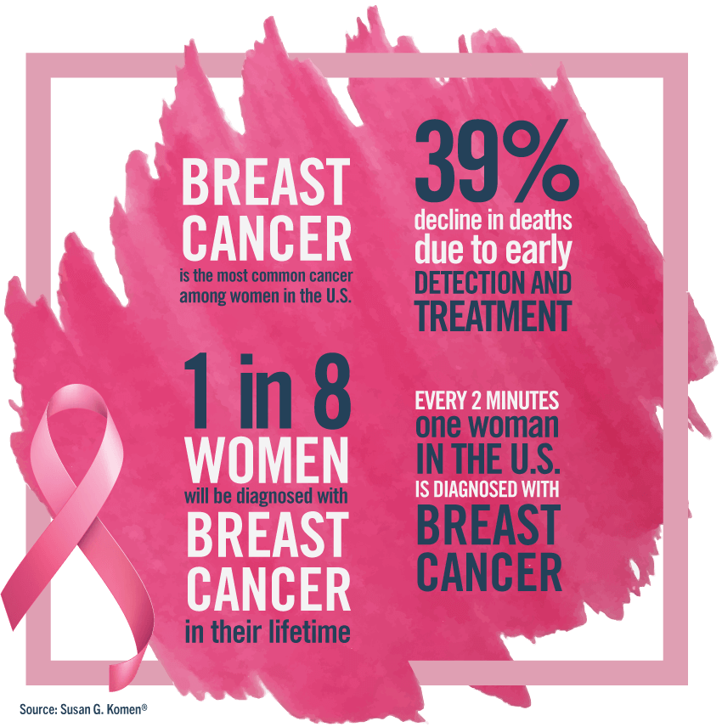
Let’s Dive In

Slide 5
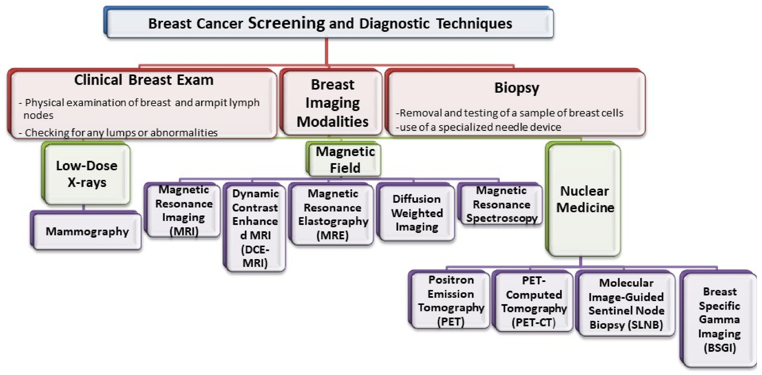
Breast Cancer Diagnosis

Slide 6
Diagnosis Breast ultrasound. A machine that uses sound waves to make pictures, called sonograms, of areas inside the breast Diagnostic mammogram. This is a more detailed X-ray of the breast Breast magnetic resonance imaging (MRI). The MRI scan will make detailed pictures of areas inside the breast. Biopsy. This is a test that removes tissue or fluid from the breast to be looked at under a microscope and do more testing.
Breast cancer diagnosis
Notes:
Staging
If breast cancer is diagnosed, other tests are done to find out if cancer cells have spread within the breast or to other parts of the body. This process is called staging. Whether the cancer is only in the breast, is found in lymph nodes under your arm, or has spread outside the breast determines your stage of breast cancer. The type and stage of breast cancer tells doctors what kind of treatment you need.
Breast ultrasound. A machine that uses sound waves to make pictures, called sonograms, of areas inside the breast.
Diagnostic mammogram. If you have a problem in your breast, such as lumps, or if an area of the breast looks abnormal on a screening mammogram, doctors may have you get a diagnostic mammogram. This is a more detailed X-ray of the breast.
Breast magnetic resonance imaging (MRI). A kind of body scan that uses a magnet linked to a computer. The MRI scan will make detailed pictures of areas inside the breast.
Biopsy. This is a test that removes tissue or fluid from the breast to be looked at under a microscope and do more testing. There are different kinds of biopsies (for example, fine-needle aspiration, core biopsy, or open biopsy).

Slide 7
Data analysis pandas as pd matplotlib.pyplot as plt plotly.express as px seaborn as sns ucimlrepo feature selection sklearn: preprocessing, mutual_info_regression sklearn.feature_selection : selectbest, selectpercentile, chi2 statmodels.api as sm statmodels.stats.outliers_influence : variance_inflation_factor model development sklearn.model_selection : train_test_split, validation_curve, cross_val_score sklearn.metrics : accuracy_score, confusion_matrix, classification_report, precision_score, recall_score, f1_score, RocCurveDisplay, roc_curve, ConfusionMatrixDisplay sklearn.linear_model: LogisticRegression sklearn.neighbors: KNeighborsClassifier sklearn.ensemble: RandomForestClassifier, GradientBoostingClassifier sklearn.tree: DecisionTreeClassifier sklearn.svm: svc xgboost: XGBClassifier
Library

Slide 8
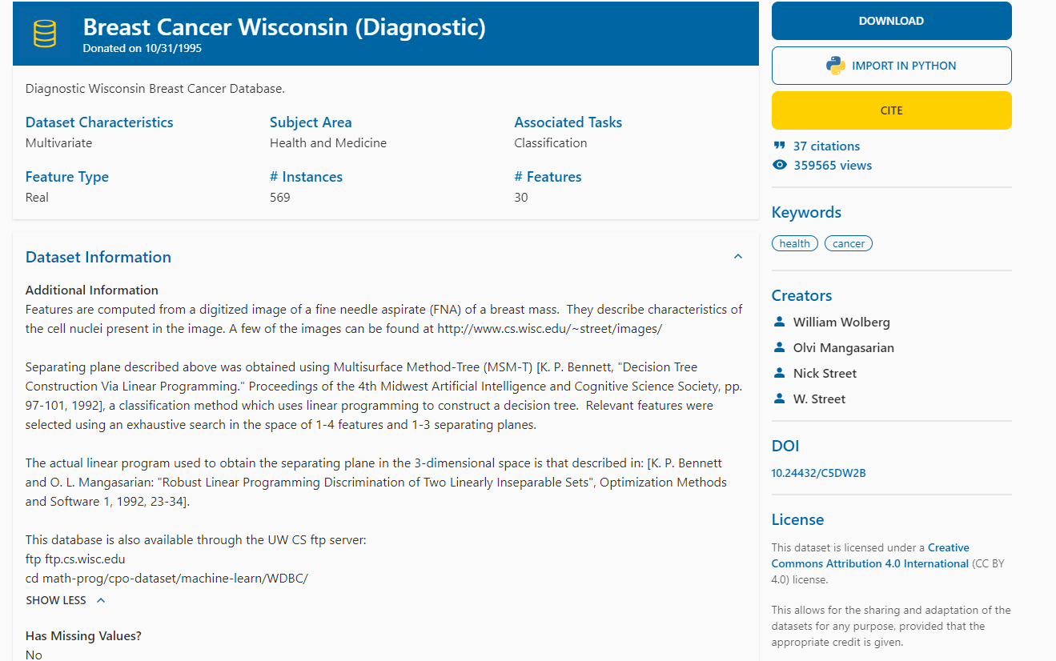
Breast cancer data set
Notes:
rea

Slide 9
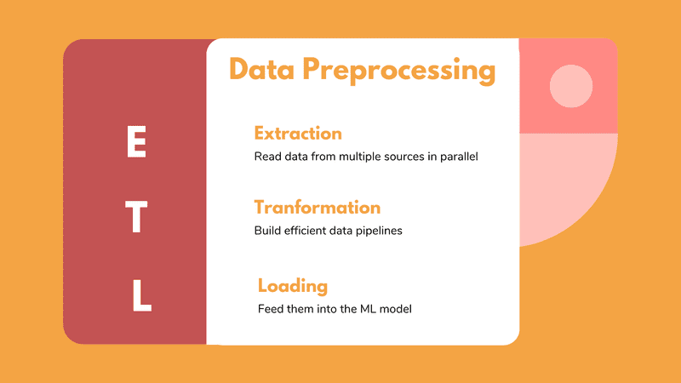
Data Preprocessing the concept of changing the raw data into a clean data set 1. Transformation 2. Multivariate analysis 3. Removing outliers and unwanted columns
Data preprocessing

Slide 10
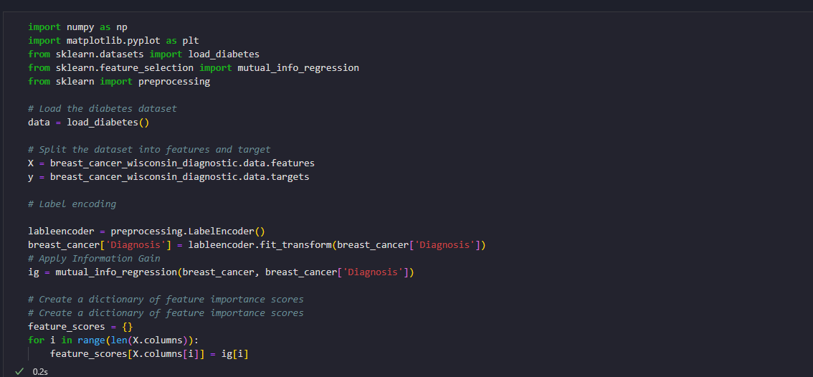
Data Preprocessing
Notes:
Diagnosis is

Slide 11
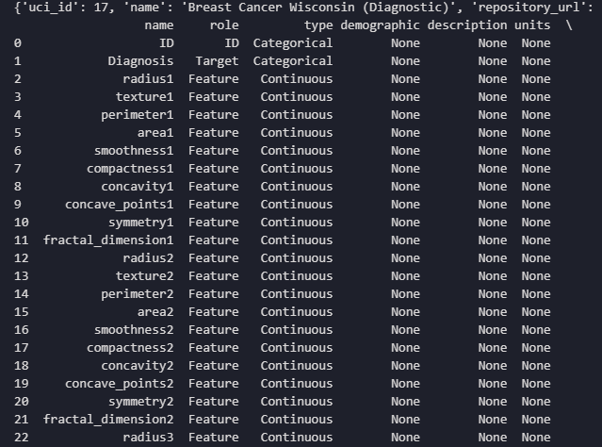
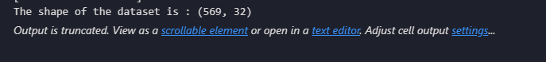
Data set: 569 observations 32 columns
Loading data

Slide 12
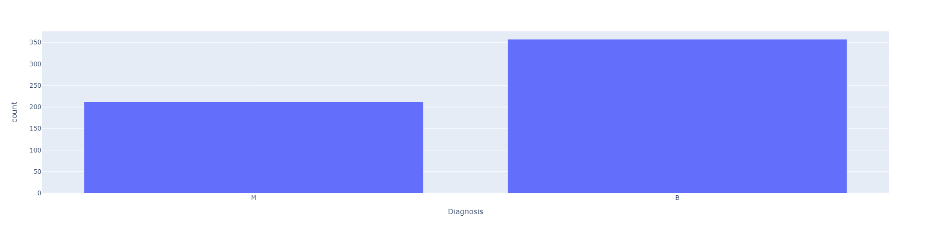
Malignant abnormal cells that divide and grow uncontrollably, benign noncancerous masses of cells that grow slowly
Diagnosis type
Notes:
Malignant cancer is a term used to describe cancer that involves abnormal cells that divide and grow uncontrollably, invading nearby tissues and potentially spreading to other parts of the body.
Benign tumors are noncancerous masses of cells that grow slowly, have distinct borders, and don't spread to other parts of the body.

Slide 13
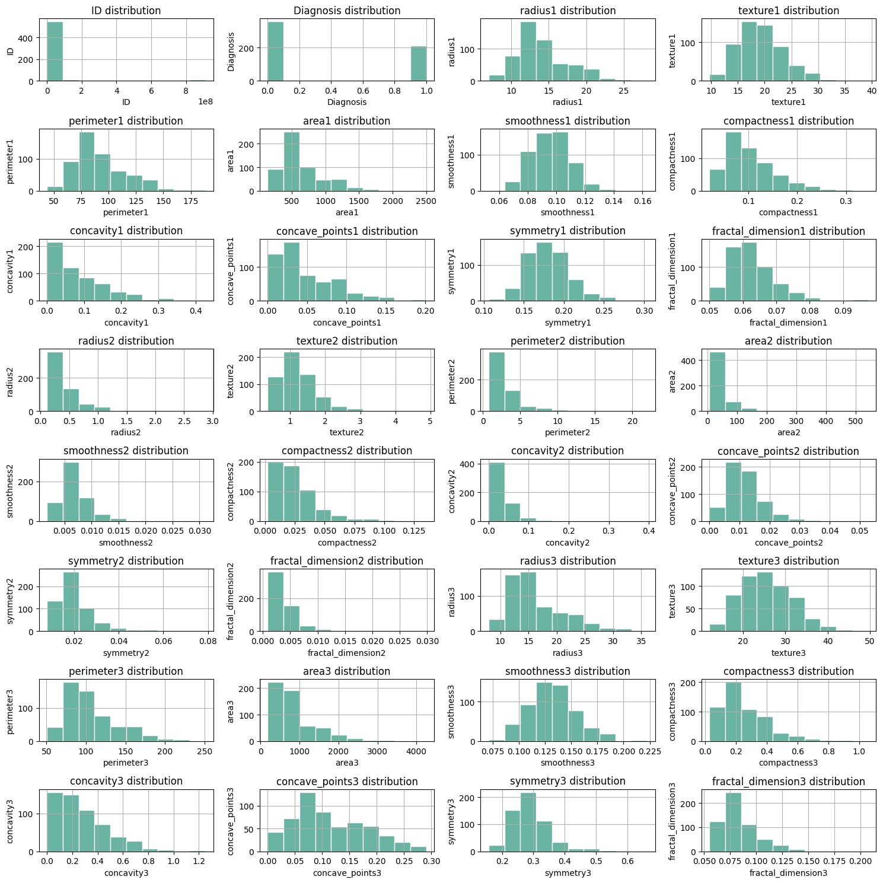
Nuclear area, perimeter, diameter, compactness, concave points are very important in differentiating benign, and malignant tumors
Numerical features
Notes:
The nuclear area, perimeter, diameter, compactness, and concave points were found to be statistically significant (P < 0.05) parameters in differentiating benign, and malignant aspirates.

Slide 14
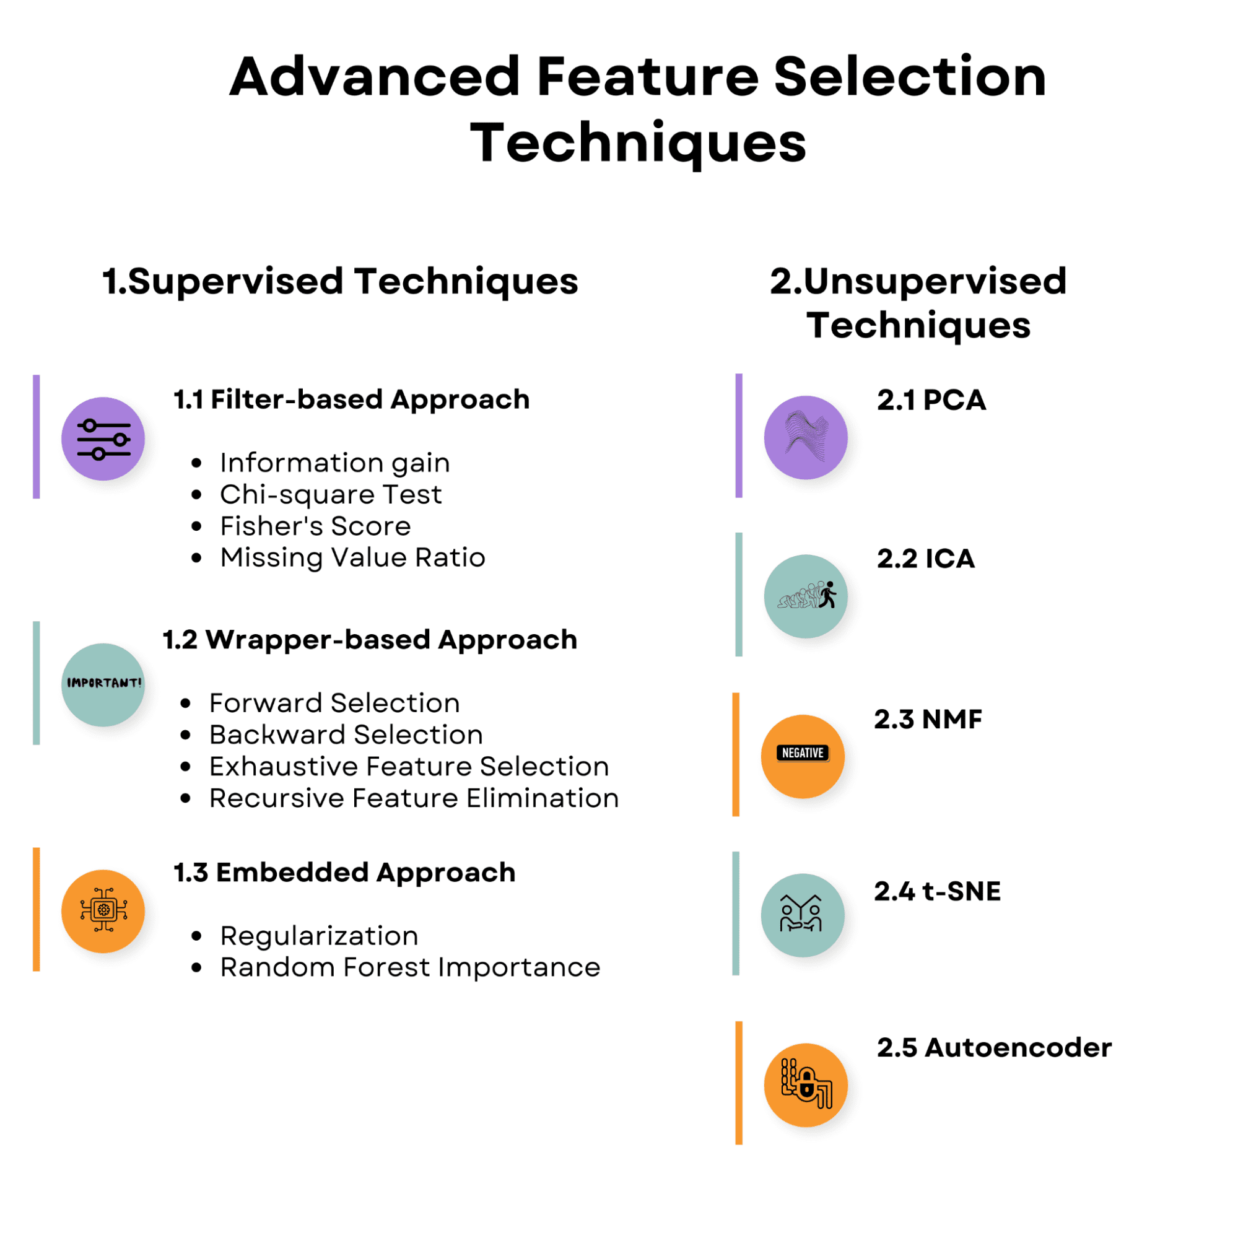

Slide 15
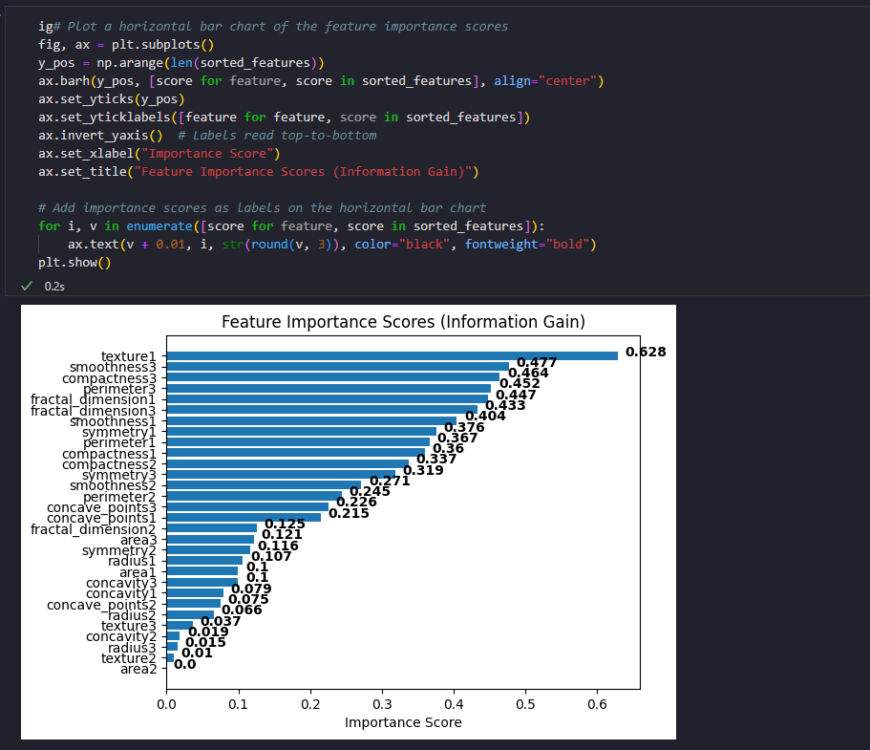
Feature importance score
Notes:
We use the Information Gain Supervised Feature Selection, which help identify the most relevant features in our dataset. We use the encoder from sklearn to change categorical values into numberical values. The features with the high information gain are typically more useful for making decisions about how to split the data in decision tree. There are also preferred for model training data as they can lead to more effective and efficient model. We can distinguish our top ranking information gains.

Slide 16
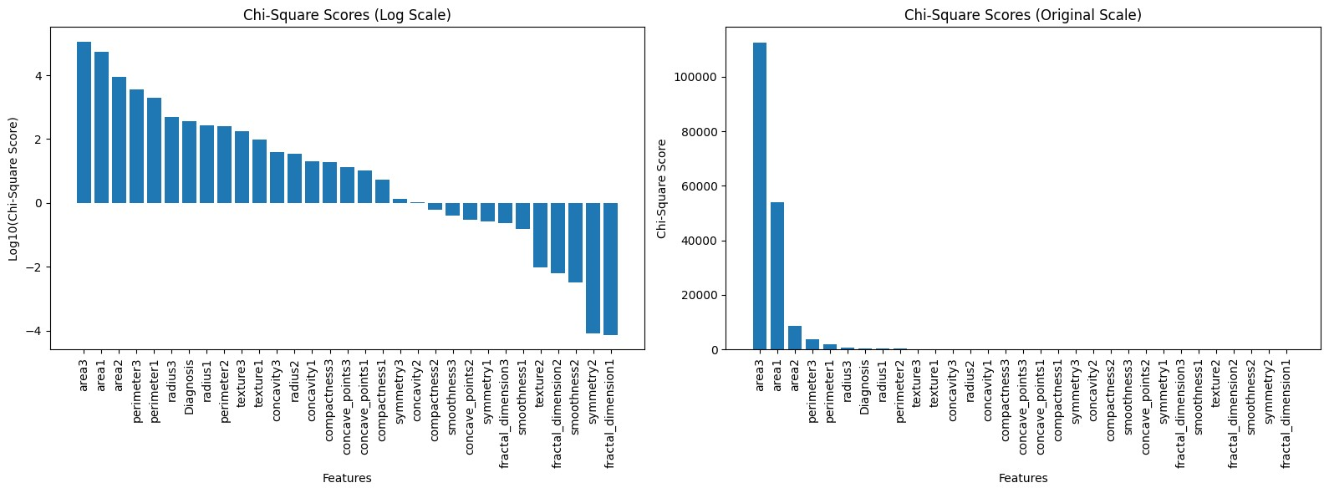
Chi-square score
Notes:
Chi-square feature selection is effective for categorical data and can identify features that are most relevant to the target variable based on their dependency.
The variables with highest score are the most relevant for modeling. We are not going to use all the Selection techniques to validate the most important features. Correlation is another method use to check the relationship among the features. Based on the correlation plots, we can agree that most the features are related.

Slide 17
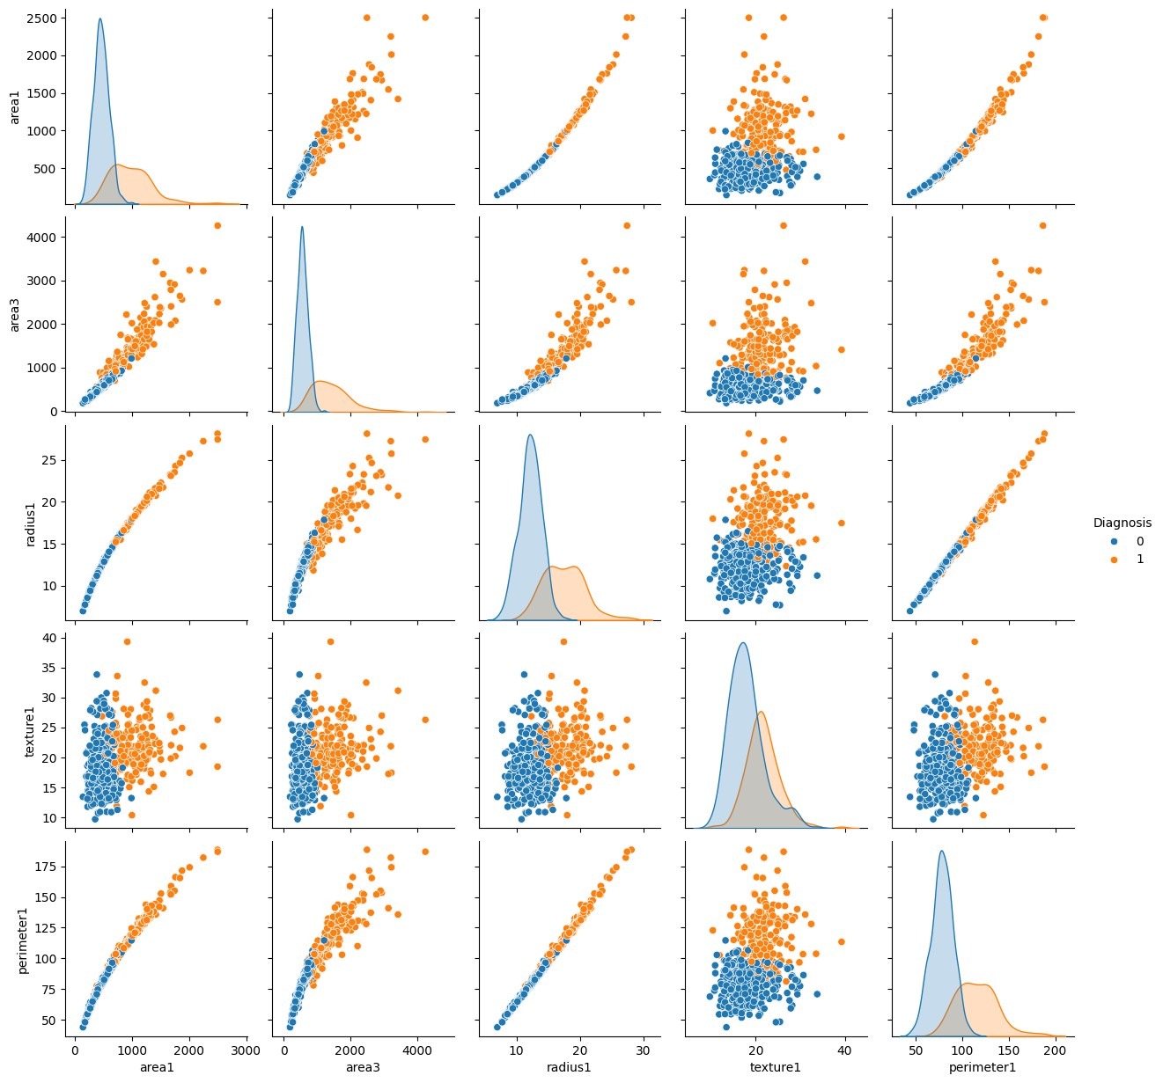
Notes:
Pairplots can help you to quickly understand the distribution of each variable, as well as the relationships between variables. This can be helpful for identifying potential areas for further investigation.

Slide 18
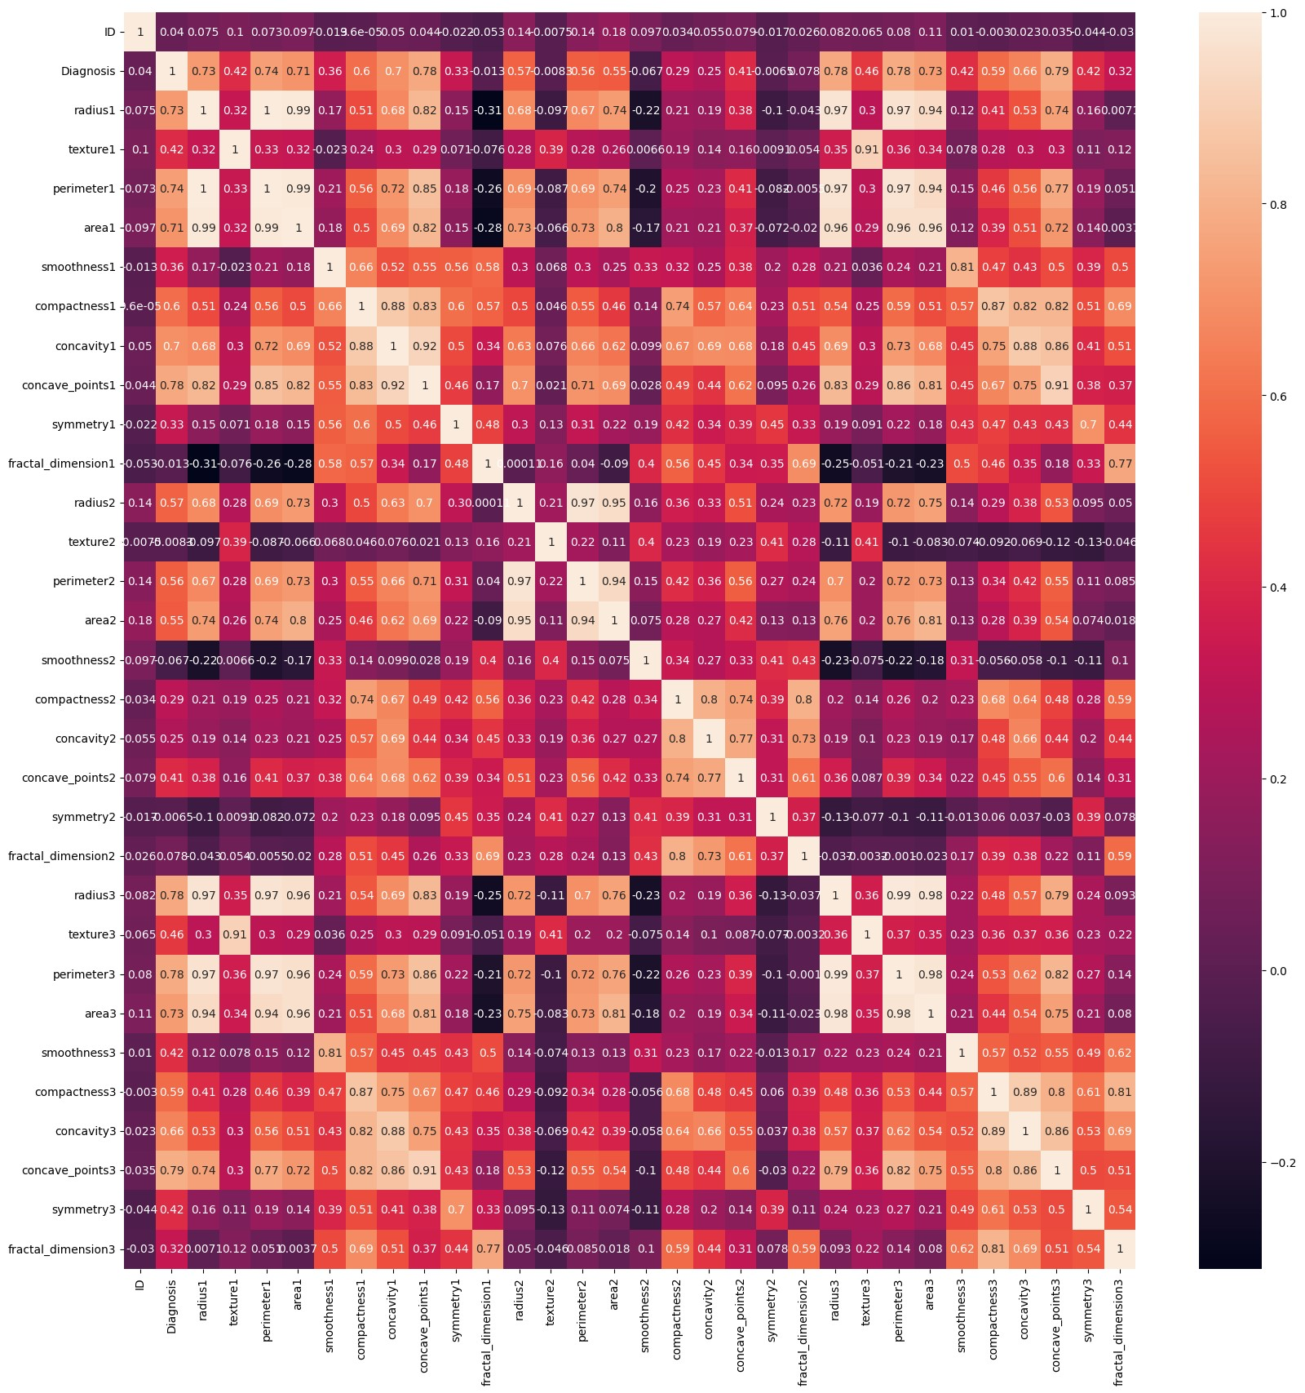
Notes:
This correlation plot highlights the relationship between all the variables. As we can see there are a lot orange box than purple box which means that our data set is ready to be modeling

Slide 19
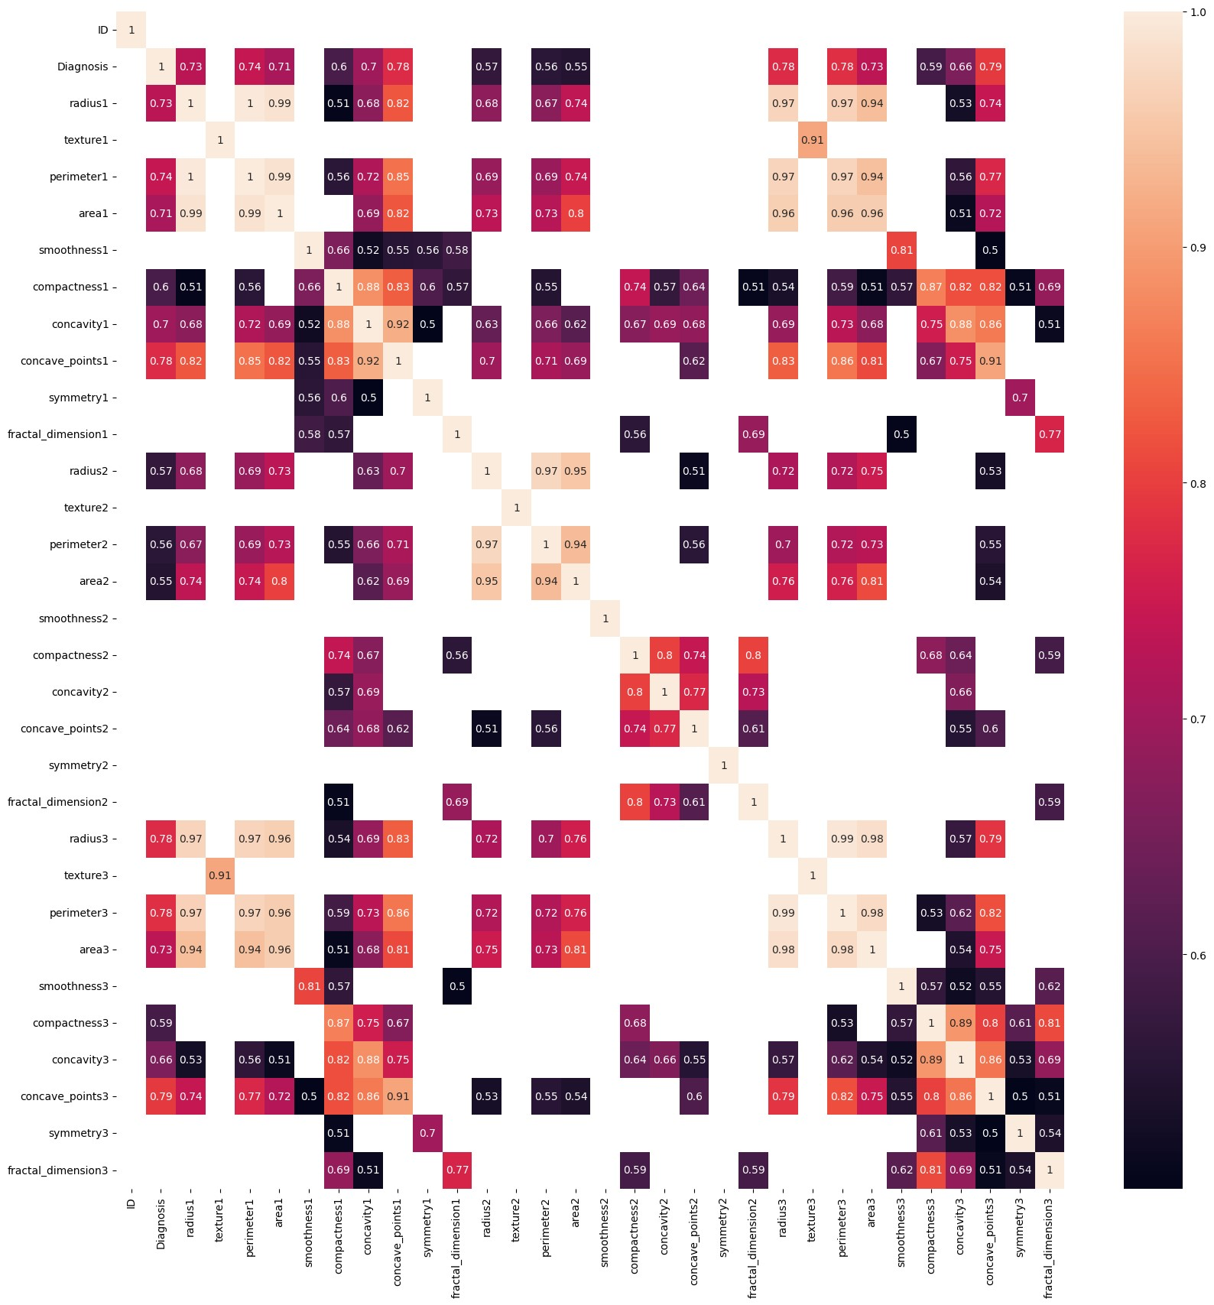

Slide 20
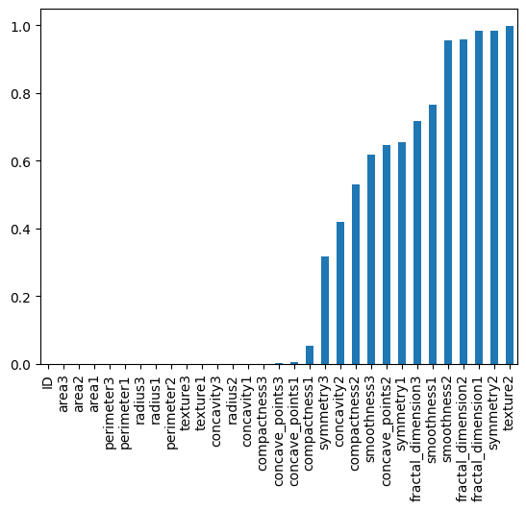
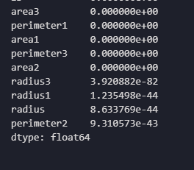
P-value (<0.05): variables with blue are statistically significant
P-value

Slide 21
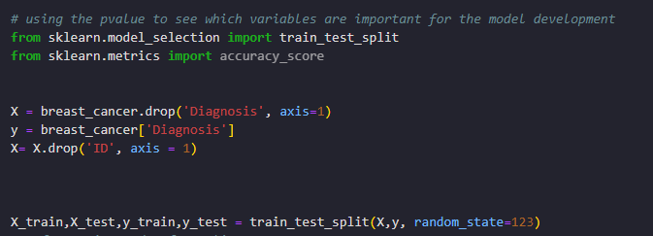
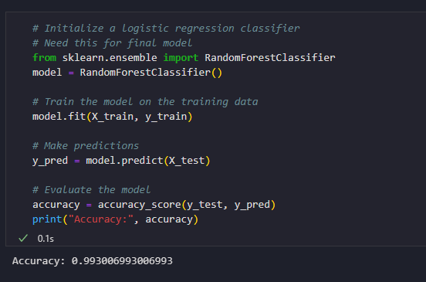
Model development
Notes:
Id represent every lab encounter for each cancer diagnosis claim.

Slide 22
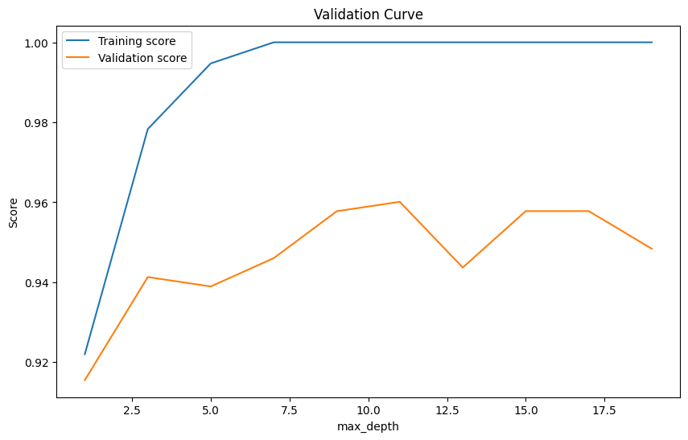
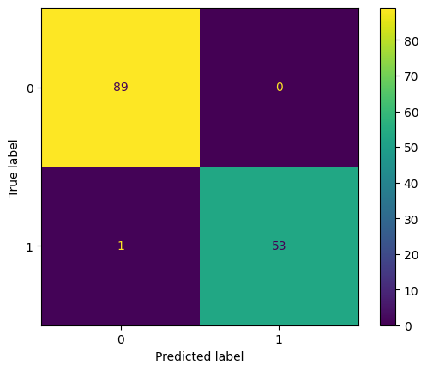
How the attributes are related?
Notes:
When the validation score displays a zigzag pattern while the training score follows a smooth curve, it suggests that the model is overfitting the training data.
Training Score (Training Performance):
The training score represents the performance of the model on the training data. As the model learns from the training data, its performance typically improves over time. This improvement is often reflected as a smooth curve because the model is optimizing itself to minimize the training error.
Validation Score (Validation Performance):
The validation score represents the performance of the model on a separate validation dataset that the model has not been trained on. It's used to estimate how well the model generalizes to unseen data.
A zigzag pattern in the validation score indicates that the model's performance fluctuates significantly as the hyperparameters change during training. This instability suggests that the model's generalization ability is not consistent across different parameter configurations.
Interpretation:
The smooth curve of the training score suggests that the model is learning and adapting well to the training data, possibly even overfitting it, as indicated by high training performance.
The zigzag pattern in the validation score indicates that the model's performance is sensitive to variations in the hyperparameters. It's struggling to generalize well to unseen data, which is a sign of overfitting.
The model was correctly able to predict 53 cancer diagnosis as benign, 89 cancer diagnosis as malignant, 0 incorrectly predicted as not benign and 1 incorrectly predicted cancer diagnosis as malignant

Slide 23
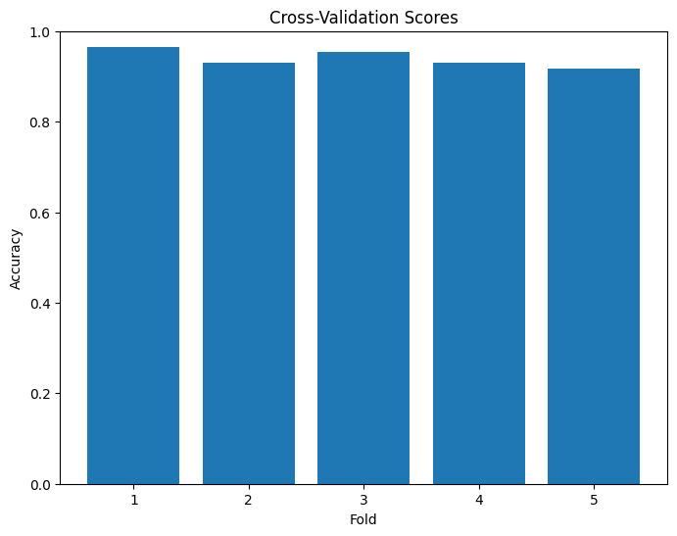
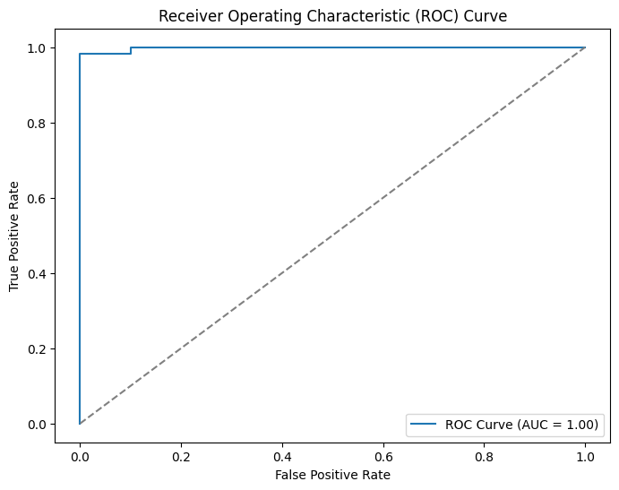
How the attributes are related?
Notes:
The overall trend along the folds has accuracy of .99 which indicates that the model is overfitting. This AUC means there is a 100% chance that the model will be able to distinguish between positive class and negative class.

Slide 24
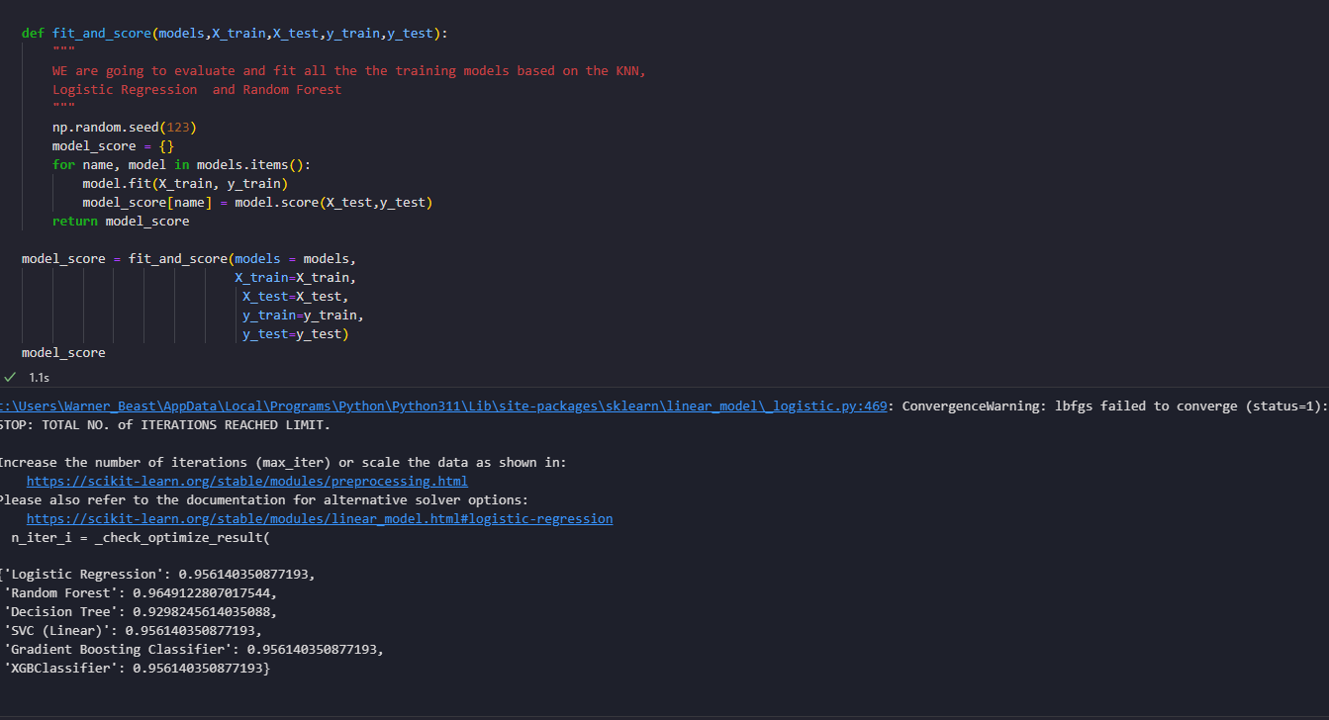
Evaluation

Slide 25
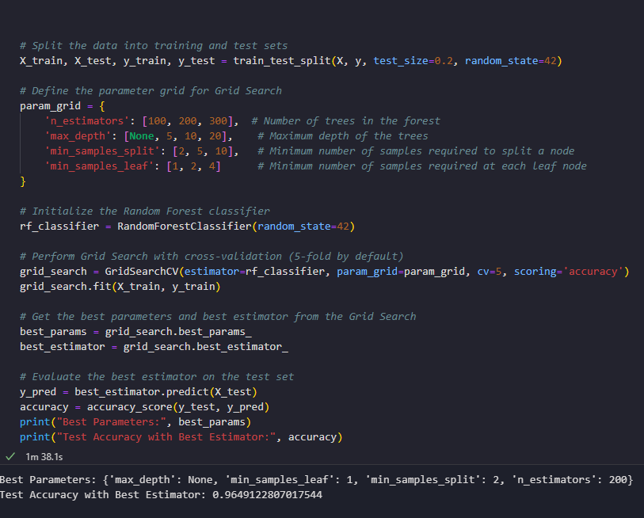
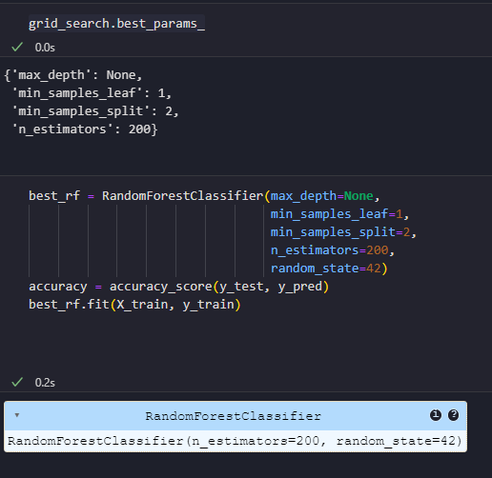
Hyper-parameters

Slide 26
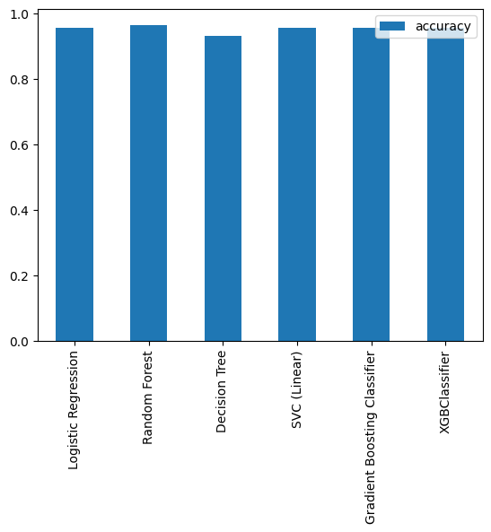
Evaluation

Slide 27
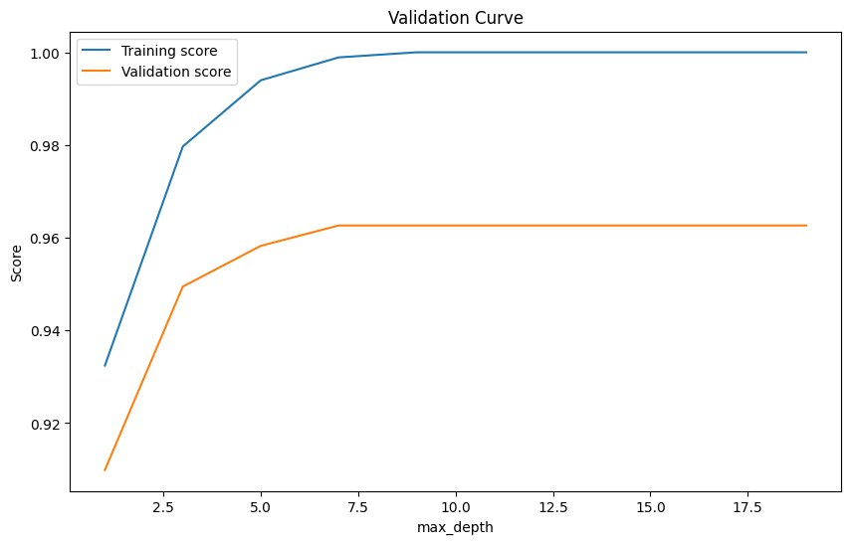
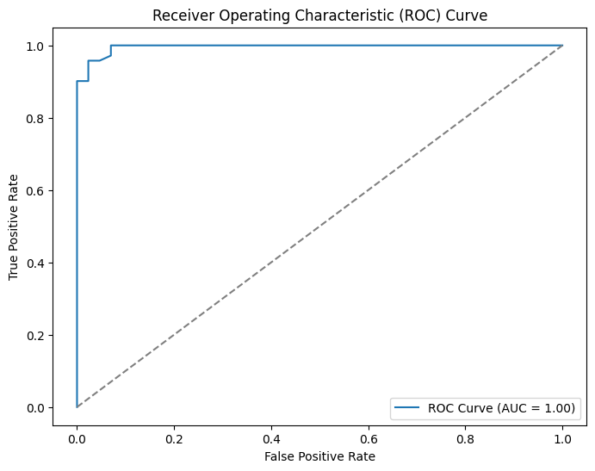
Best model summary

Slide 28
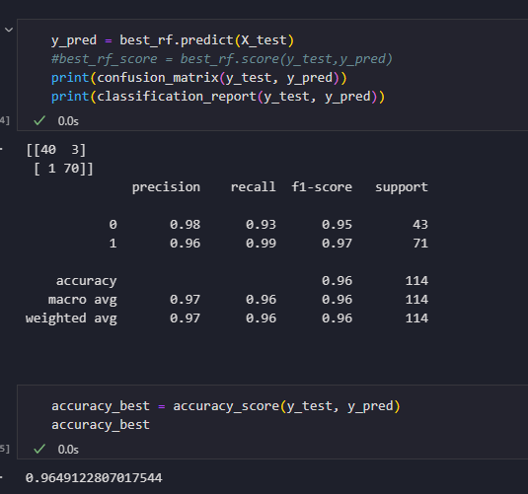
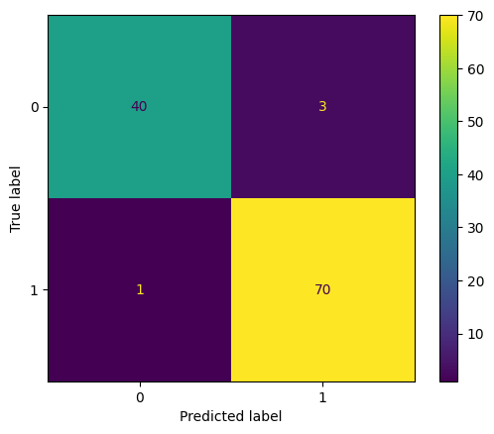
Best model summary
Notes:
The model was correctly able to predict 70 cancer diagnosis as benign, 40 cancer diagnosis as malignant, 3 incorrectly predicted as not benign and 1 incorrectly predicted cancer diagnosis as malignant

Slide 29
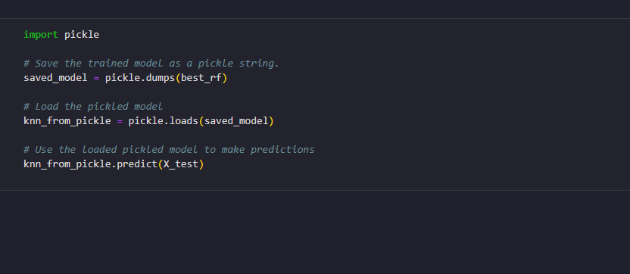
Exporting the model

Slide 30
We are able to predict Breast cancer diagnosis using random forest classifier. We evaluated multiple classification models in order to select the best model. Healthcare data can be difficult to model based on the numbers of outliers found in residual analysis. Dealing with outliers in healthcare data requires careful consideration and domain expertise. It's essential to assess whether the outliers represent genuine anomalies or errors, and to choose appropriate methods for handling them, such as robust regression techniques, data transformation, or outlier detection algorithms.

Slide 31
references
Wolberg,William, Mangasarian,Olvi, Street,Nick, and Street,W.. (1995). Breast Cancer Wisconsin (Diagnostic). UCI Machine Learning Repository. https://doi.org/10.24432/C5DW2B.
Wolberg WH, Street WN, Mangasarian OL. Image analysis and machine learning applied to breast cancer diagnosis and prognosis. Anal Quant Cytol Histol. 1995 Apr;17(2):77-87. PMID: 7612134.
Bhushan A, Gonsalves A, Menon JU. Current State of Breast Cancer Diagnosis, Treatment, and Theranostics. Pharmaceutics. 2021 May 14;13(5):723. doi: 10.3390/pharmaceutics13050723. PMID: 34069059; PMCID: PMC8156889.
1. supervised learning. scikit. (n.d.). https://scikit-learn.org/stable/supervised_learning.html#supervised-learning
Centers for Disease Control and Prevention. (2023, July 25). How is breast cancer diagnosed?. Centers for Disease Control and Prevention. https://www.cdc.gov/cancer/breast/basic_info/diagnosis.htm
Narasimha A, Vasavi B, Kumar HM. Significance of nuclear morphometry in benign and malignant breast aspirates. Int J Appl Basic Med Res. 2013 Jan;3(1):22-6. doi: 10.4103/2229-516X.112237. PMID: 23776836; PMCID: PMC3678677.

Slide 32



THANK YOU
Warner Alexis
00000000000
WARNER.ALEXIS44@spsmail.cuny.edu
Breast cancer prediction

